Slide 1
JDBC

Slide 2
Introduction
JDBC stands for Java Database Connectivity.
It is a standard Java API for database-independent connectivity between the Java programming language and a wide range of databases.
  It was developed by JavaSoft, a subsidiary of Sun Microsystems.
The JDBC library includes APIs for each of the tasks:
  Making a connection to a database
  Creating SQL or MySQL statements
  Executing that SQL or MySQL queries in the database
  Viewing & Modifying the resulting records.
JDBC packages java.sql and javax.sql.

Slide 3
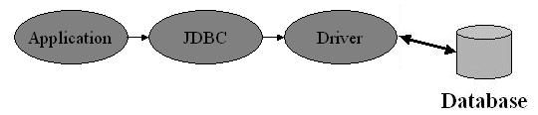
JDBC Architecture
General JDBC Architecture consists of two layers:
  JDBC API: This provides the application-to-JDBC Manager connection.
  JDBC Driver API: This supports the JDBC Manager-to-Driver Connection.
The JDBC API uses a driver manager and database-specific drivers to provide transparent connectivity to heterogeneous databases.

Slide 4
JDBC Architecture
JDBC is an API specification developed by Sun Microsystems that defines a uniform interface for accessing various relational databases
JDBC is a core part of the Java platform and is included in the standard JDK distribution
The primary function of the JDBC API is to provide a means for the developer to issue SQL statements and process the results in a consistent, database-independent manner

Slide 5
Cont..
JDBC provides rich, object-oriented access to databases by defining classes and interfaces that represent objects such as:
  Database connections
  SQL statements
  Result Set
  Database metadata
  Prepared statements
  Binary Large Objects (BLOBs)
  Character Large Objects (CLOBs)
  Callable statements
  Database drivers
  Driver manager

Slide 6
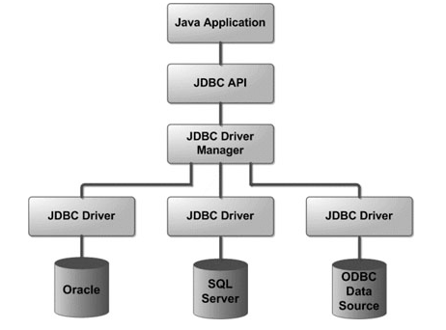
Architectural Diagram

Slide 7
Common JDBC Components
DriverManager
This class manages a list of database drivers.
Matches connection requests from the java application with the proper database.
Driver
This interface which will connect java application and database system.
Database – MySQL, MS-access, Oracle,DB2, Sybase
Different drivers according to different database.
Driver manager handles drivers.

Slide 8
Con’t
Connection
This interface with all methods for contacting a database.
All communication with database is through connection object.
Statement
This interface is use to submit the SQL statements to the database.
ResultSet
These objects hold data retrieved from a database after you execute an SQL query using Statement objects. It acts as an iterator to allow you to move through its data.
SQLException
This class handles any errors that occur in a database application.

Slide 9
JDBC Drivers
A JDBC driver translates standard JDBC calls into a network or database protocol or into a database library API call that facilitates communication with the database
This translation layer provides JDBC applications with database independence
If the back-end database changes, only the JDBC driver need be replaced with few code modifications required.
There are four distinct types of JDBC drivers.

Slide 10
Types of Drivers
Four Types:
Type 1: JDBC-ODBC Bridge driver (Bridge)
Type 2: Native-API/partly Java driver (Native)
Type 3: AllJava/Net-protocol driver (Middleware)
Type 4: All Java/Native-protocol driver (Pure)

Slide 11
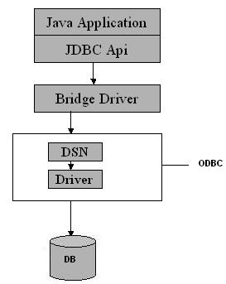
Type 1 JDBC-ODBC Bridge driver
The Type 1 driver translates all JDBC calls into ODBC calls and sends them to the ODBC driver.
The JDBC-ODBC Bridge driver is recommended only for experimental use and is typically used for development and testing purposes only.

Slide 12
Con’t
Advantage
The JDBC-ODBC Bridge allows access to almost any database, since the database's ODBC drivers are already available.
Disadvantages
Since the Bridge driver is not written fully in Java, Type 1 drivers are not portable.
A performance issue is seen as a JDBC call goes through the bridge to the ODBC driver, then to the database, and this applies even in the reverse process.
  They are the slowest of all driver types.
The client system requires the ODBC Installation to use the driver.
Not good for the Web.

Slide 13
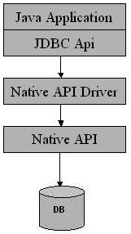
Type 2 Native-API/partly Java driver
Type 2 drivers convert JDBC calls into database-specific calls.
  i.e. this driver is specific to a particular database.
  E.g. : Oracle will have oracle native api.

Slide 14
Con’t
Advantage
They typically offer better performance than the JDBC-ODBC Bridge as the layers of communication (tiers) are less than that of Type1 and also it uses Native api which is Database specific.
Disadvantage
Native API must be installed in the Client System and hence type 2 drivers cannot be used for the Internet.
Like Type 1 drivers, it’s not written in Java Language which forms a portability issue.
If we change the Database we have to change the native api as it is specific to a database.
Mostly obsolete now.
Usually not thread safe.

Slide 15
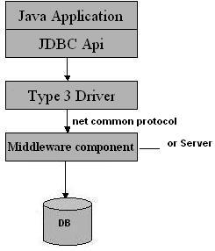
Type 3 All Java/Net-protocol driver
Type 3 database requests are passed through the network to the middle-tier server.
The middle-tier then translates the request to the database. If the middle-tier server can in turn use Type1, Type 2 or Type 4 drivers.

Slide 16
Con’t
Advantage
This driver is server-based, so there is no need for any vendor database library to be present on client machines.
This driver is fully written in Java and hence Portable. It is suitable for the web.
There are many opportunities to optimize portability, performance, and scalability.
The net protocol can be designed to make the client JDBC driver very small and fast to load.
This driver is very flexible allows access to multiple databases using one driver.
They are the most efficient amongst all driver types.
Disadvantage
It requires another server application to install and maintain.
Traversing the recordset may take longer, since the data comes through the backend server.

Slide 17
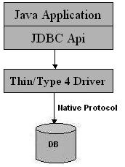
Type 4 Native-protocol/all-Java driver
The Type 4 uses java networking libraries to communicate directly with the database server.

Slide 18
Con’t
Advantage
They are completely written in Java to achieve platform independence.
It is most suitable for the web.
Number of translation layers is very less
i.e. type 4 JDBC drivers don't have to translate database requests to ODBC or a native connectivity interface or to pass the request on to another server, performance is typically quite good.
You don’t need to install special software on the client or server. Further, these drivers can be downloaded dynamically.
Disadvantage
With type 4 drivers, the user needs a different driver for each database.

Slide 19
Which Driver should be used?
If you are accessing one type of database, such as Oracle, Sybase, or IBM, the preferred driver type is 4.
If your Java application is accessing multiple types of databases at the same time, type 3 is the preferred driver.
Type 2 drivers are useful in situations where a type 3 or type 4 driver is not available.
The type 1 is typically used for development and testing purposes only.

Slide 20
1. Loading a database driver
try {
// Class.forName (String ClassName)
Class.forName(”sun.jdbc.odbc.JdbcOdbcDriver”); //Or any other driver
}catch(Exception x){
System.out.println (“Unable to load the driver class!”);
}

Slide 21
2. Creating a oracle jdbc Connection
try{
Connection dbConnection =
DriverManager.getConnection(url,”loginName”,”Password”
} catch( SQLException x ){
System.out.println (“Couldn’t get connection!”);
}
DriverManager class manages the JDBC drivers that are installed on the system.
Its getConnection () method is used to establish a connection to a database.
It uses a username, password, and a jdbc url to establish a connection to the database and returns a connection object.
A jdbc Connection represents a session/connection with a specific database.

Slide 22
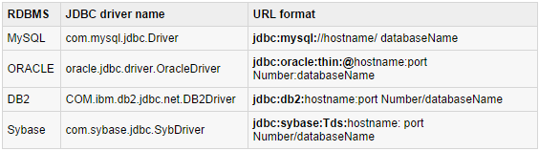
Con’t
An application can have one or more connections with a single database, or it can have many connections with different databases.
A Connection object provides metadata i.e. information about the database, tables, and fields.

Slide 23
3. Creating a jdbc Statement object
Three kinds of Statements:
Statement - Execute simple sql queries without parameters.
  Useful when you are using static SQL statements at runtime.
Statement createStatement ()
  Statement statement = dbConnection.createStatement ();
Prepared Statement - Execute precompiled sql queries with or without parameters.
  It can accept input parameters at runtime.
  PreparedStatement prepareStatement (String sql)
  PreparedStatement objects are precompiled SQL statements.
Callable Statement - Execute a call to a database stored procedure.
  It can accept runtime input parameters.
  CallableStatement prepareCall (String sql)
  CallableStatement objects are SQL stored procedure call statements.

Slide 24
4. Executing a SQL statement
Three methods for executing statements:
All 3 statement can return ResultSet Object.
ResultSet executeQuery(String SQL) - For a SELECT statement
int executeUpdate(String SQL) - For statements that create or modify tables(Insert, Update, Delete, Alter, Drop)
boolean execute(String SQL) - executes an SQL statement that is written as String object.
  Returns a boolean value of true if a ResultSet object can be retrieved; otherwise, it returns false.
  Use this method to execute SQL DDL statements or when you need to use truly dynamic SQL.

Slide 25
ResultSet
ResultSet provides access to a table of data generated by executing a Statement.
The table rows are retrieved in sequence.
A ResultSet maintains a cursor pointing to its current row of data.
The next () method is used to successively step through the rows of the tabular results.
By default, only one ResultSet object per Statement object can be open at the same time.

Slide 26
Methods of ResultSet
  All method throws SQLException
Navigating a Result Set:
void beforeFirst()
void afterLast()
boolean first()
void last()
boolean previous()
boolean next()
int getRow()
Viewing a Result Set:
int getInt(String columnName)
int getInt(int columnIndex)

Slide 27
Con’t
Updating a Result Set
void updateString(int columnIndex, String s)
void updateString(String columnName, String s)
void updateRow()
void deleteRow()
void insertRow()

Slide 28
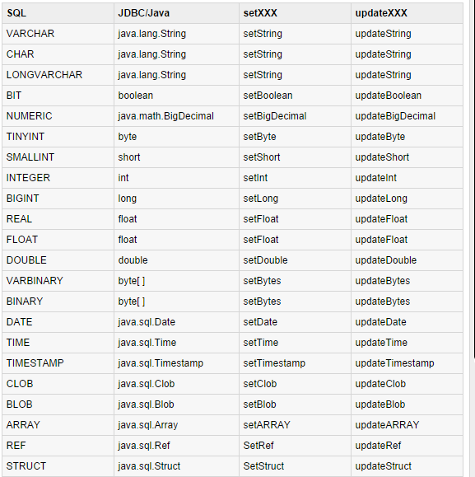
DataTypes

Slide 29
Con’t
Use to call the setXXX() method of the PreparedStatement or CallableStatement object or the ResultSet.updateXXX() method.
ResultSet object provides corresponding getXXX() method for each data type to retrieve column value.
  Each method can be used with column name or by its ordinal position.

Slide 30
Con’t
TestStatement.java
TestPrepStatement.java
JDBCExample.java
StatementBatchDemo.java
PrepStatementBatch.java
TestBatch.java
JDBCFrameDemo.java

